Slide 1

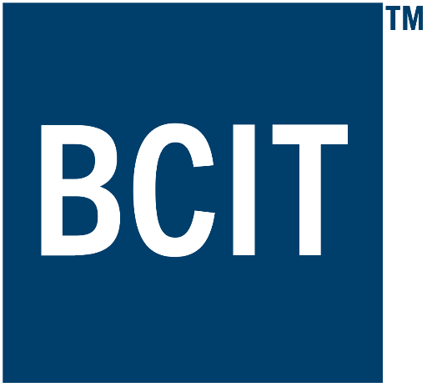
Applied Virtual Networks
COMP 4912
Instructor: Dawood Sajjadi
PhD, SMIEEE, CISSP
ssajjaditorshizi@bcit.ca
Winter-Spring 2025
Week #10

Slide 2
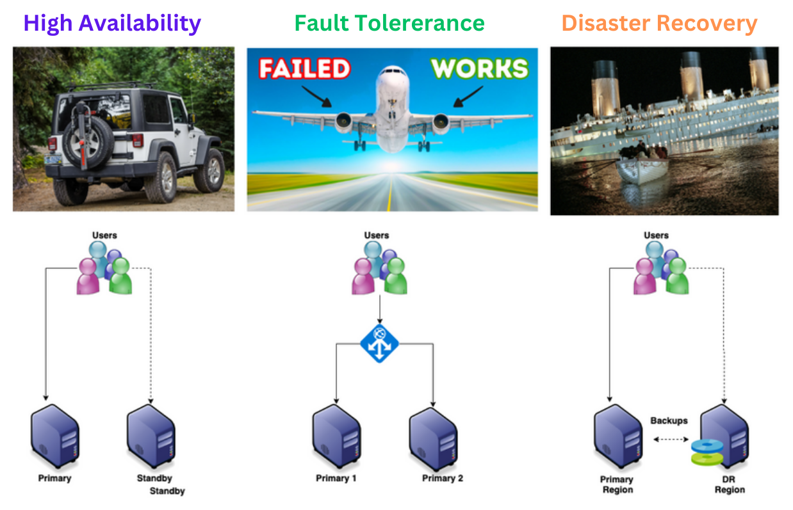
HA vs. FT vs. DR
RECAP
Notes:
High Availability does not mean that the systems is not expected to have downtime. A Highly Available system can have downtime but the systems should be designed to be up and running with minimal efforts in case of a failure.
A Fault-Tolerant Design enables a system to continue its intended operation, possibly at a reduced level, rather than failing completely, when some part of the system fails
Disaster Recovery assumes that the primary site is not recoverable (at least for some time) and represents a process of restoring data and services to a secondary survived site

Slide 3
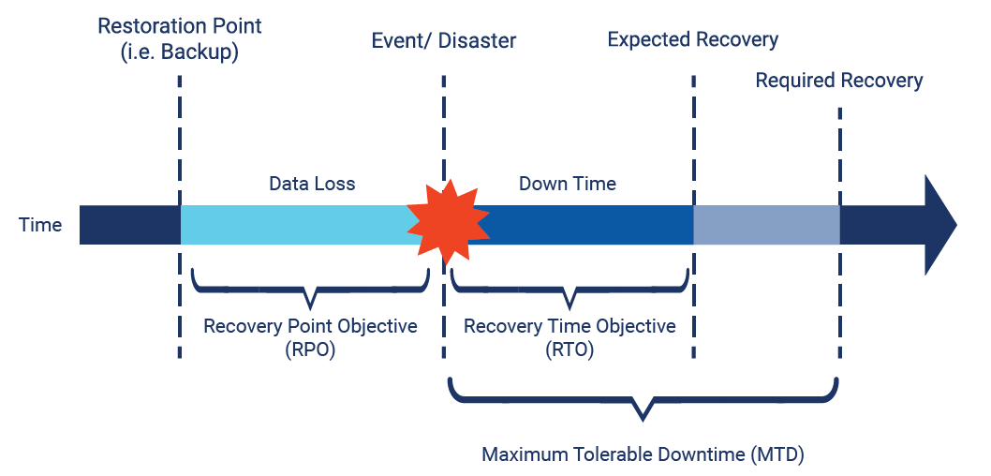
Metrics for Service Monitoring
RECAP
There are several known metrics that help to define service Reliability, Availability, and Disaster Recovery strategies.
SLO (Service Level Objective)
A targeted performance goal used internally by service teams.
Defines desired service levels (Latency < 100ms, or Uptime > 99.95%).
SLA (Service Level Agreement)
A formal contract between a service provider and a customer.
Defines minimum service guarantees (e.g., 99.99% uptime).
Includes penalties if the provider fails to meet commitments.
RPO (Recovery Point Objective)
Maximum amount of data loss a company can tolerate.
RTO (Recovery Time Objective)
Maximum time allowed to restore operations after a disruption.
RSL (Recovery Service Level)
The percentage of a service that must be available during a disaster.

Slide 4
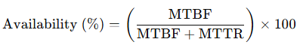
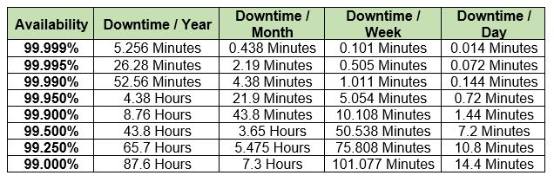
Five-Nine SLA (99.999%)
RECAP
MTBF (Mean Time Between Failures)
The average time a system runs before experiencing a failure.
A higher MTBF means fewer failures, increasing overall uptime.
Example: If a server has an MTBF of 200,000 hours, it fails less frequently.
Higher MTBF → Fewer failures → Better uptime
Lower MTTR → Faster recovery → Better uptime
MTTR (Mean Time To Repair)
The average time taken to repair and restore service after a failure.
A lower MTTR reduces downtime, improving availability.
Example: If an incident occurs and the service is restored in 5 minutes, it helps maintain high uptime.
5 nine
4 nine
3 nine
2 nine
https://aws.amazon.com/blogs/publicsector/achieving-five-nines-cloud-justice-public-safety/

Slide 5
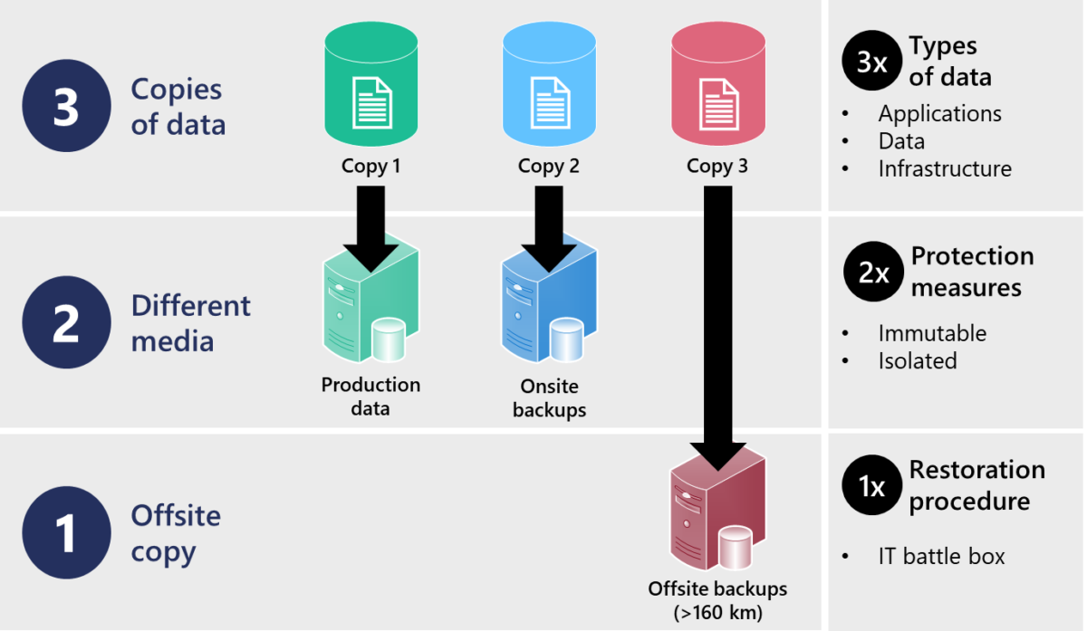
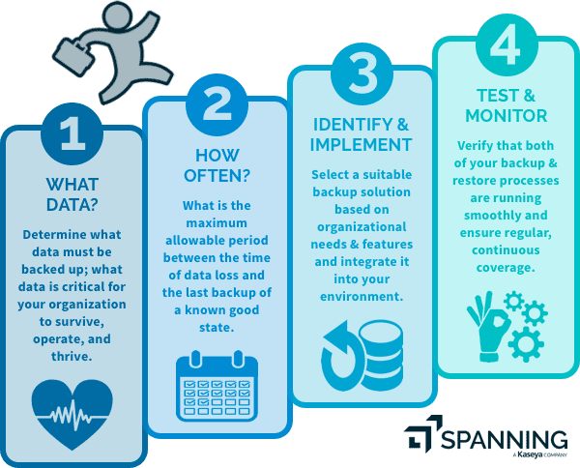
Backup Strategies
RECAP
3-2-1 Backup Rule

Slide 6
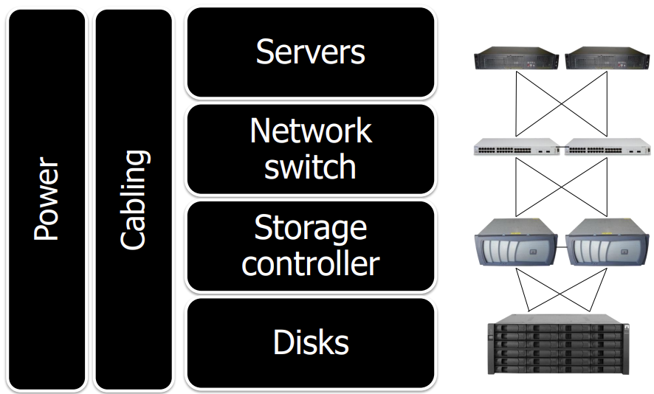
Complete Redundancy
RECAP
https://people.duke.edu/~tkb13/courses/ece566-2020fa/slides/09-ha.pdf

Slide 7
Learning Outcomes of Week #10
Understand the core concepts of Cybersecurity.
Better understanding about Threat Landscape and Emerging Threats.
Explaining key factors to consider for building a Secure Infrastructure.
Understanding major elements to build a Secured Virtualized Environment.
Describing the roles of Security Compliances and Standards.

Slide 8
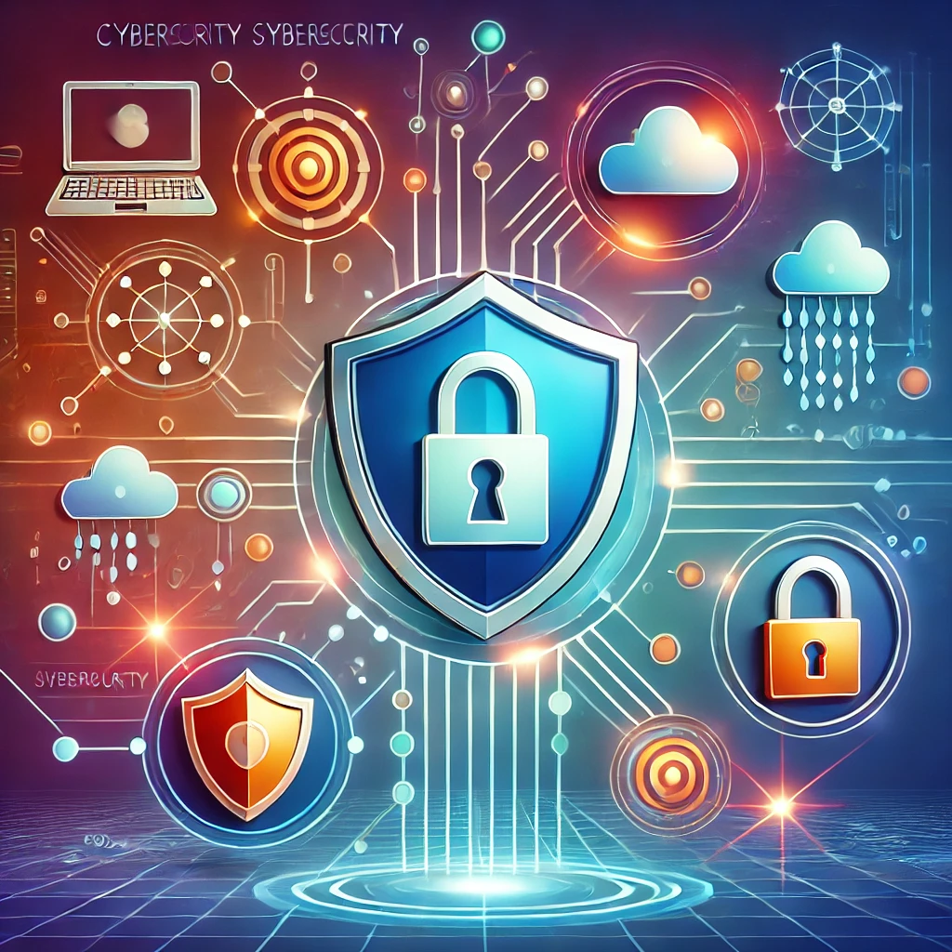
Cyber Security
Cybersecurity is the practice of protecting systems, networks, and programs from digital attacks.
Key Areas
Application Security
Information Security
Network Security
Operational Security
Notes:
Version History
8.0 (May 2020)
All slides reformatted for 16:9 aspect ratio
All slides updated to 8th edition material
Use of Calibri font, rather that Gill Sans MT
Add LOTS more animation throughout
lighter header font
wireless security completely redone (updated WiFi and added 4G/5G)
SSL material replaces by TLS 1.3 (up-to-date)
V8.2 (Feb 2022)
Minor corrections

Slide 9
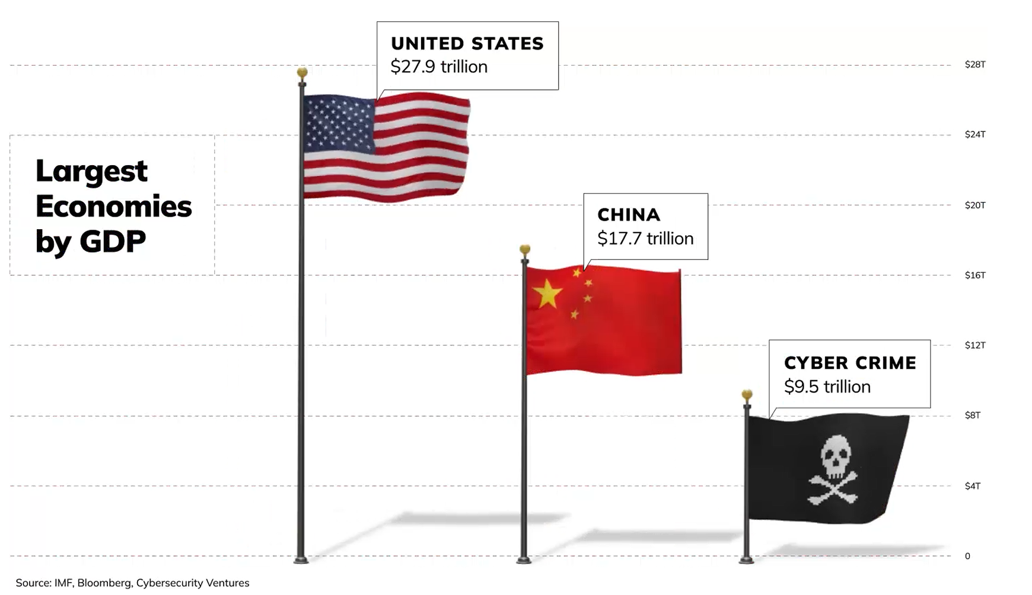
Cyber Crime: The World’s Third-Largest Economy
Apr 2024
Notes:
Did you know that if cybercrime were a country, it would rank as the third largest economy in the world by GDP? In Apr 2024, the global cybercrime economy was worth $9.5 trillion.
This staggering fact underscores the importance of security awareness.
April 2024: https://sponsored.bloomberg.com/quicksight/check-point/the-worlds-third-largest-economy-has-bad-intentions-and-its-only-getting-bigger
World Economic Forum describes it as “the dark underbelly of the digital era.”
Although these cyber criminals are scattered around the globe, they form a well-oiled franchise in aggregate, with ransom money paid by victims and distributed into the recruiting, R&D, ransomware negotiations, bitcoin laundering, and malware and encrypter development that enable the next attack.

Slide 10
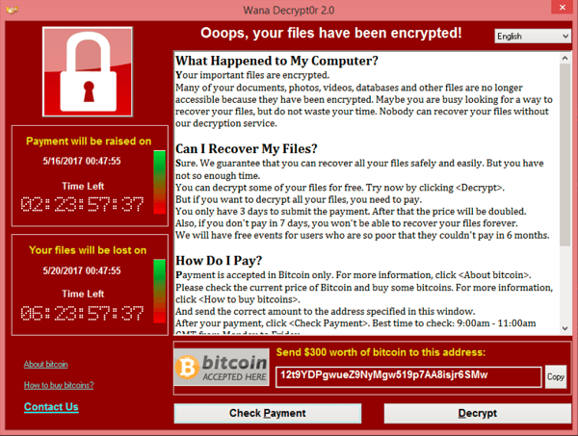
Cyber Security
WannaCry Ransomware Attack
Friday, 12 May 2017
Major Common Threats
Phishing
Malware/Spyware/Adware…
Denial-of-Service (DoS) attack
Man-in-the-Middle (MitM) attack
Crypto-mining/Crypto-Heist
Impacts
Data breaches
Financial loss
Reputational damage
Infected more than 300,000 computers in over 150 countries [approximate damage: up to $8 billion ]
NO ONE is 100% Secure
Notes:
Version History
8.0 (May 2020)
All slides reformatted for 16:9 aspect ratio
All slides updated to 8th edition material
Use of Calibri font, rather that Gill Sans MT
Add LOTS more animation throughout
lighter header font
wireless security completely redone (updated WiFi and added 4G/5G)
SSL material replaces by TLS 1.3 (up-to-date)
V8.2 (Feb 2022)
Minor corrections

Slide 11
Top Human Risks – SANS 2024
Social Engineering
Notes:
SysAdmin, Audit, Network, and Security -> SANS
SANS is the world's largest cybersecurity research and training organization.
Among all human related risks, social eng is the top concern.
If security awareness programs are ultimately about managing human risks, which human risks are organizations most concerned about? Figure 3, below, shows that respondents cite one human related
risk above all others as their top concern, Social Engineering (Phishing/Vishing/Smishing).

Slide 12
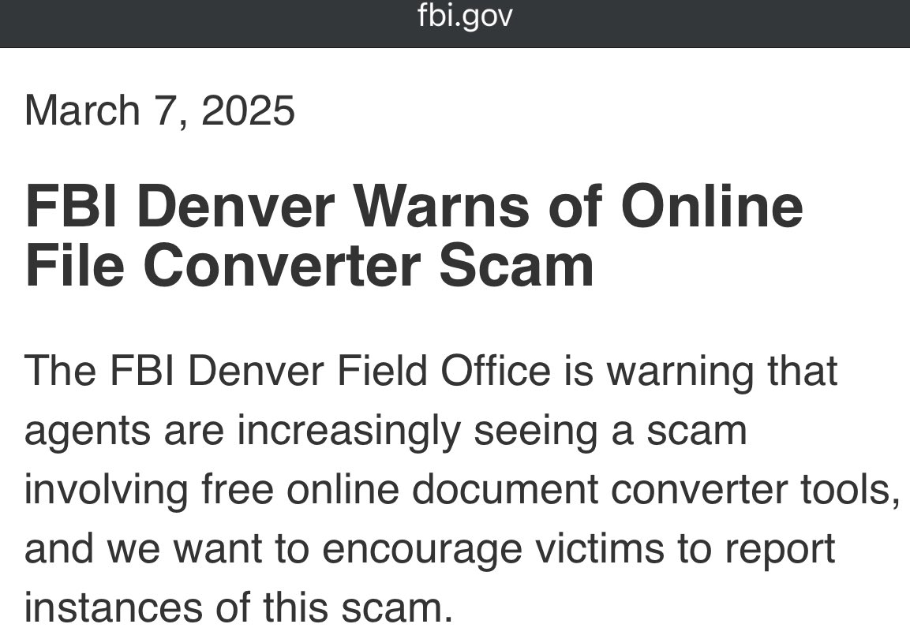
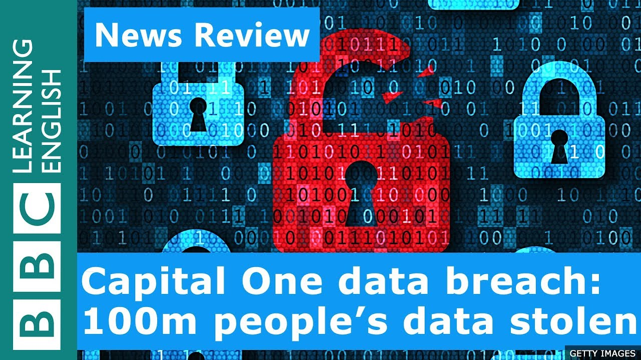
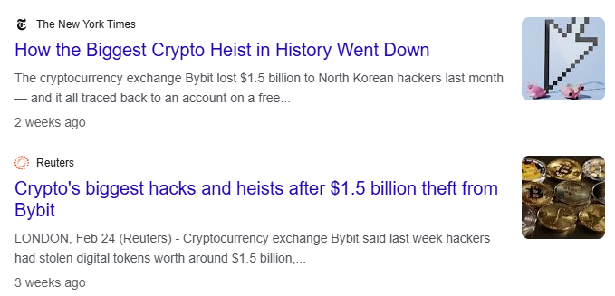
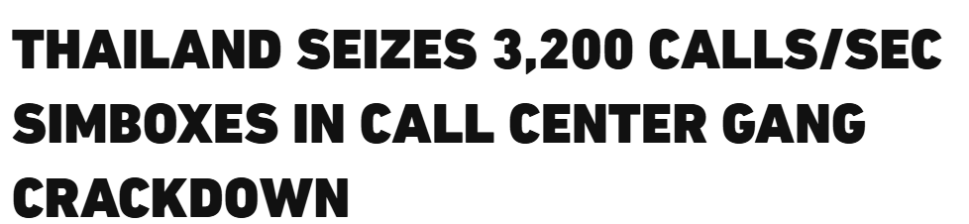
Cyber Security
Twitter/X: @5tuxnet
2024

Slide 13
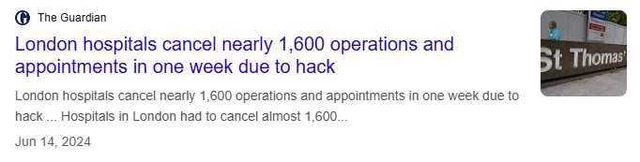
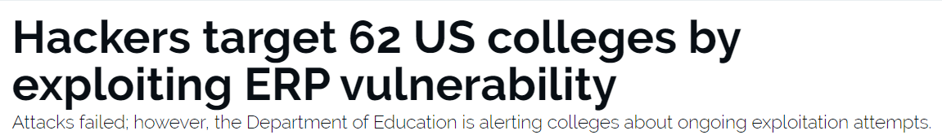
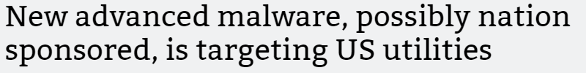
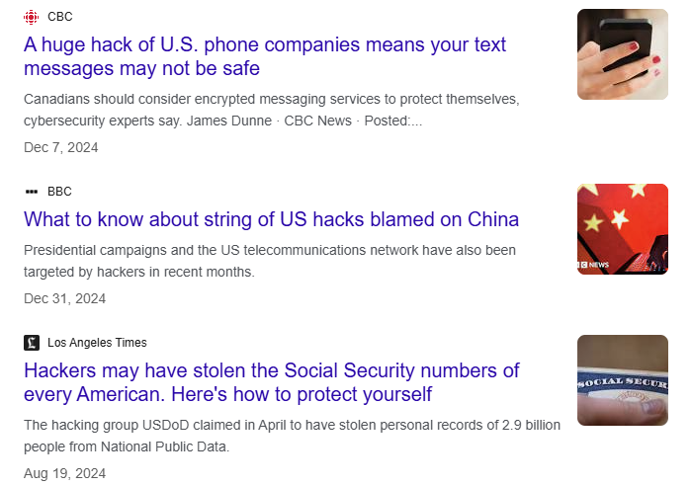
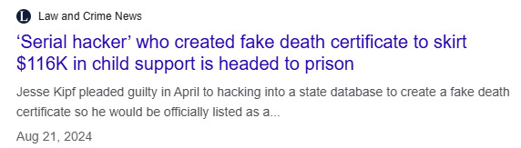
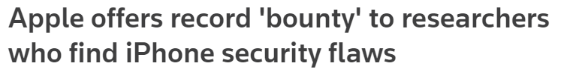
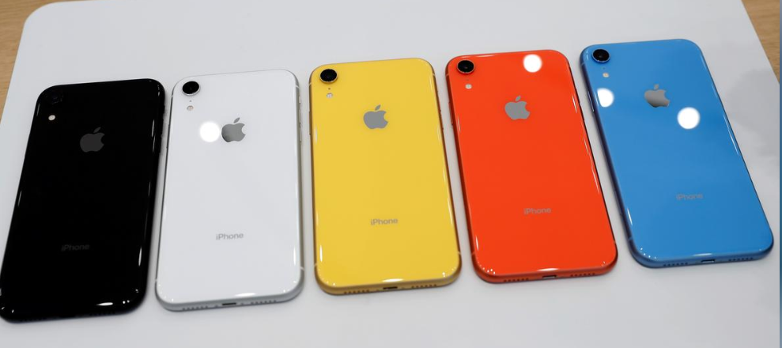
Cyber Security
Twitter/X: @5tuxnet
ZDNet, July 19, 2019
Arstechnica, August 2, 2019
Reuters, August 8, 2019
up to $ 1 million

Slide 14
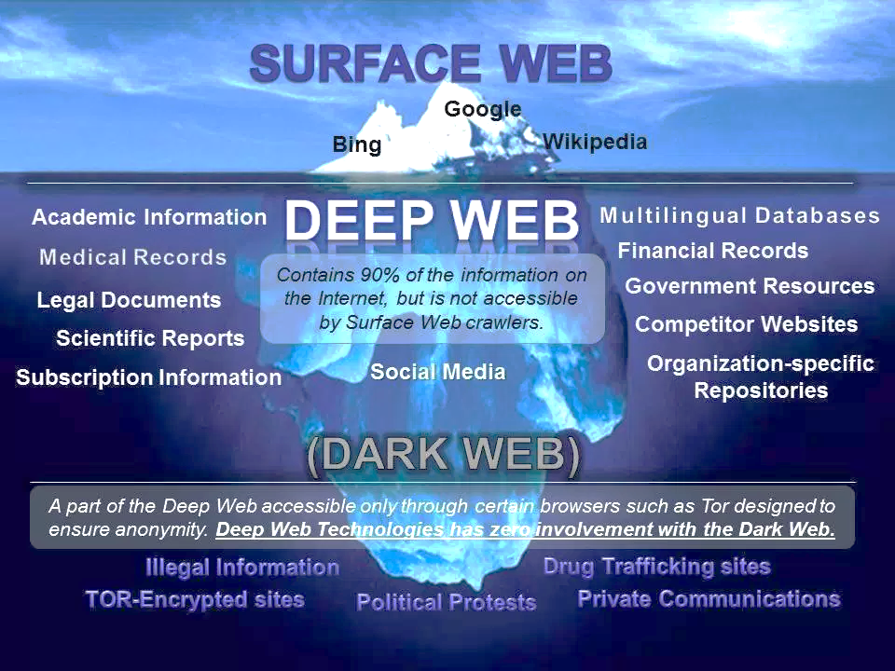

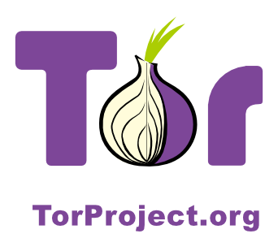
Cyber Security
Public Internet
Private Internet
Notes:
Version History
8.0 (May 2020)
All slides reformatted for 16:9 aspect ratio
All slides updated to 8th edition material
Use of Calibri font, rather that Gill Sans MT
Add LOTS more animation throughout
lighter header font
wireless security completely redone (updated WiFi and added 4G/5G)
SSL material replaces by TLS 1.3 (up-to-date)
V8.2 (Feb 2022)
Minor corrections

Slide 15
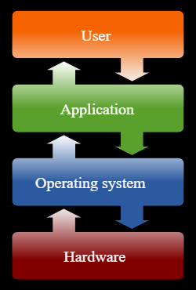
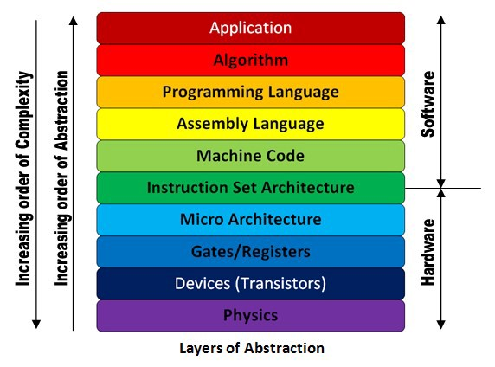
Cyber Security
Notes:
Version History
8.0 (May 2020)
All slides reformatted for 16:9 aspect ratio
All slides updated to 8th edition material
Use of Calibri font, rather that Gill Sans MT
Add LOTS more animation throughout
lighter header font
wireless security completely redone (updated WiFi and added 4G/5G)
SSL material replaces by TLS 1.3 (up-to-date)
V8.2 (Feb 2022)
Minor corrections

Slide 16
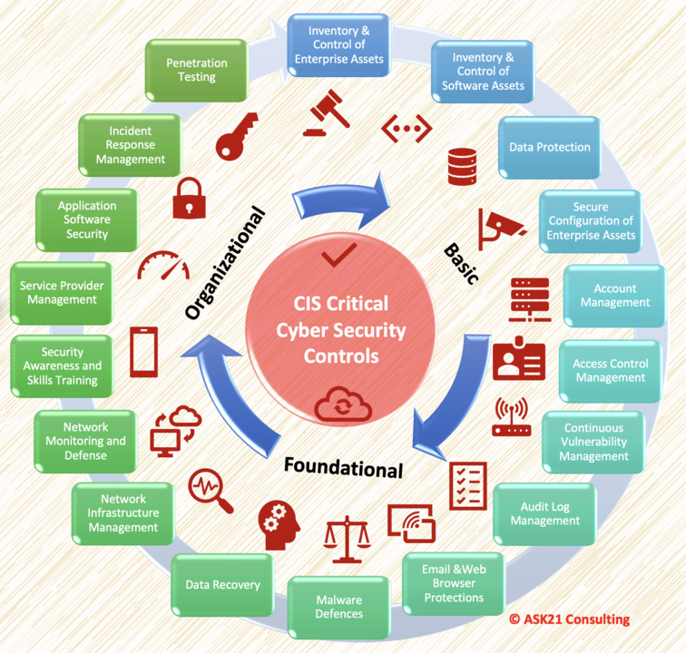
Cyber Security
Basic Measures
Use strong and unique passwords (password manager)
Enable two-factor authentication (2FA)
Regularly update your OS/Applications
Do Not Install Unknown software
Advanced Measures
Network segmentation
Encryption (at-rest, in-transit, in-use)
Continuous Monitoring and Incident Response
Role of Individuals
Importance of personal responsibility and awareness
Notes:
Version History
8.0 (May 2020)
All slides reformatted for 16:9 aspect ratio
All slides updated to 8th edition material
Use of Calibri font, rather that Gill Sans MT
Add LOTS more animation throughout
lighter header font
wireless security completely redone (updated WiFi and added 4G/5G)
SSL material replaces by TLS 1.3 (up-to-date)
V8.2 (Feb 2022)
Minor corrections

Slide 17
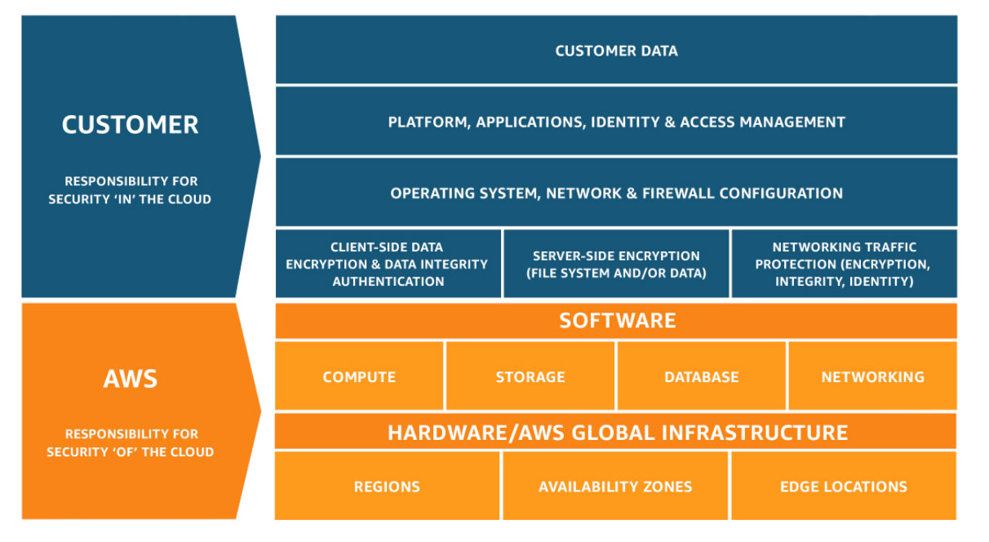
Shared Responsibility Model

Slide 18
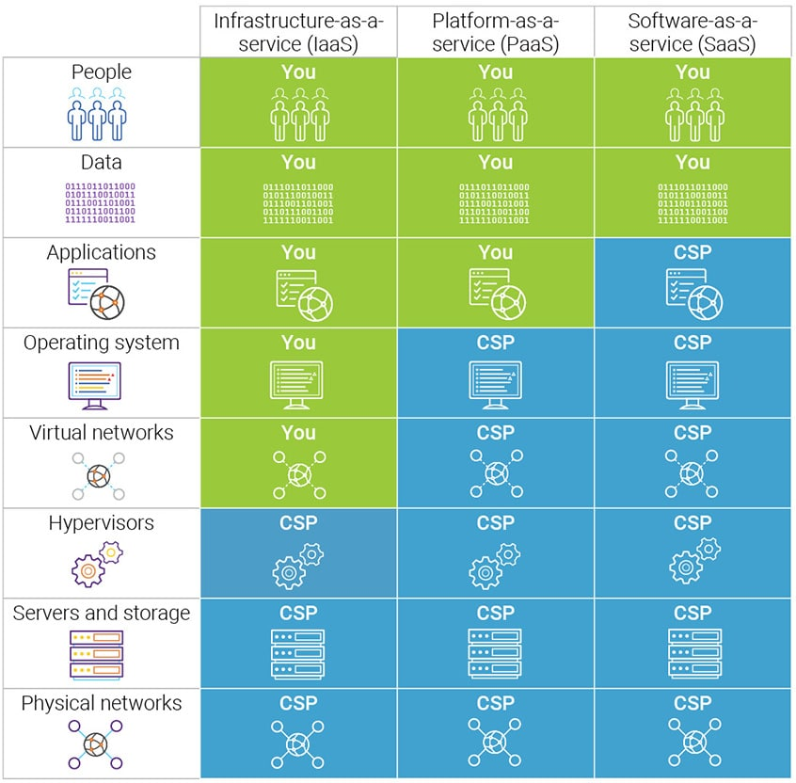
Shared Responsibility Model
Cloud Security encompasses the technologies, controls, processes, and policies which combine to protect your cloud-based systems, data, and infrastructure.
Cloud Security is a shared responsibility between you and your cloud service provider. You implement a cloud security strategy to protect your data, adhere to regulatory compliance, and protect your customers’ privacy.
https://kinsta.com/blog/cloud-security/

Slide 19
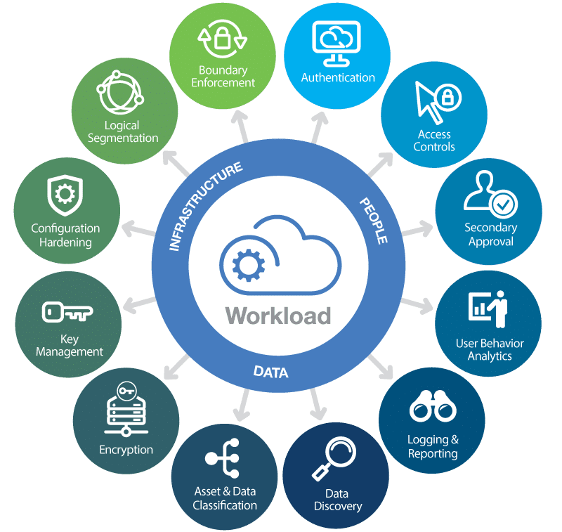
Securing your Workloads
https://kinsta.com/blog/cloud-security/

Slide 20
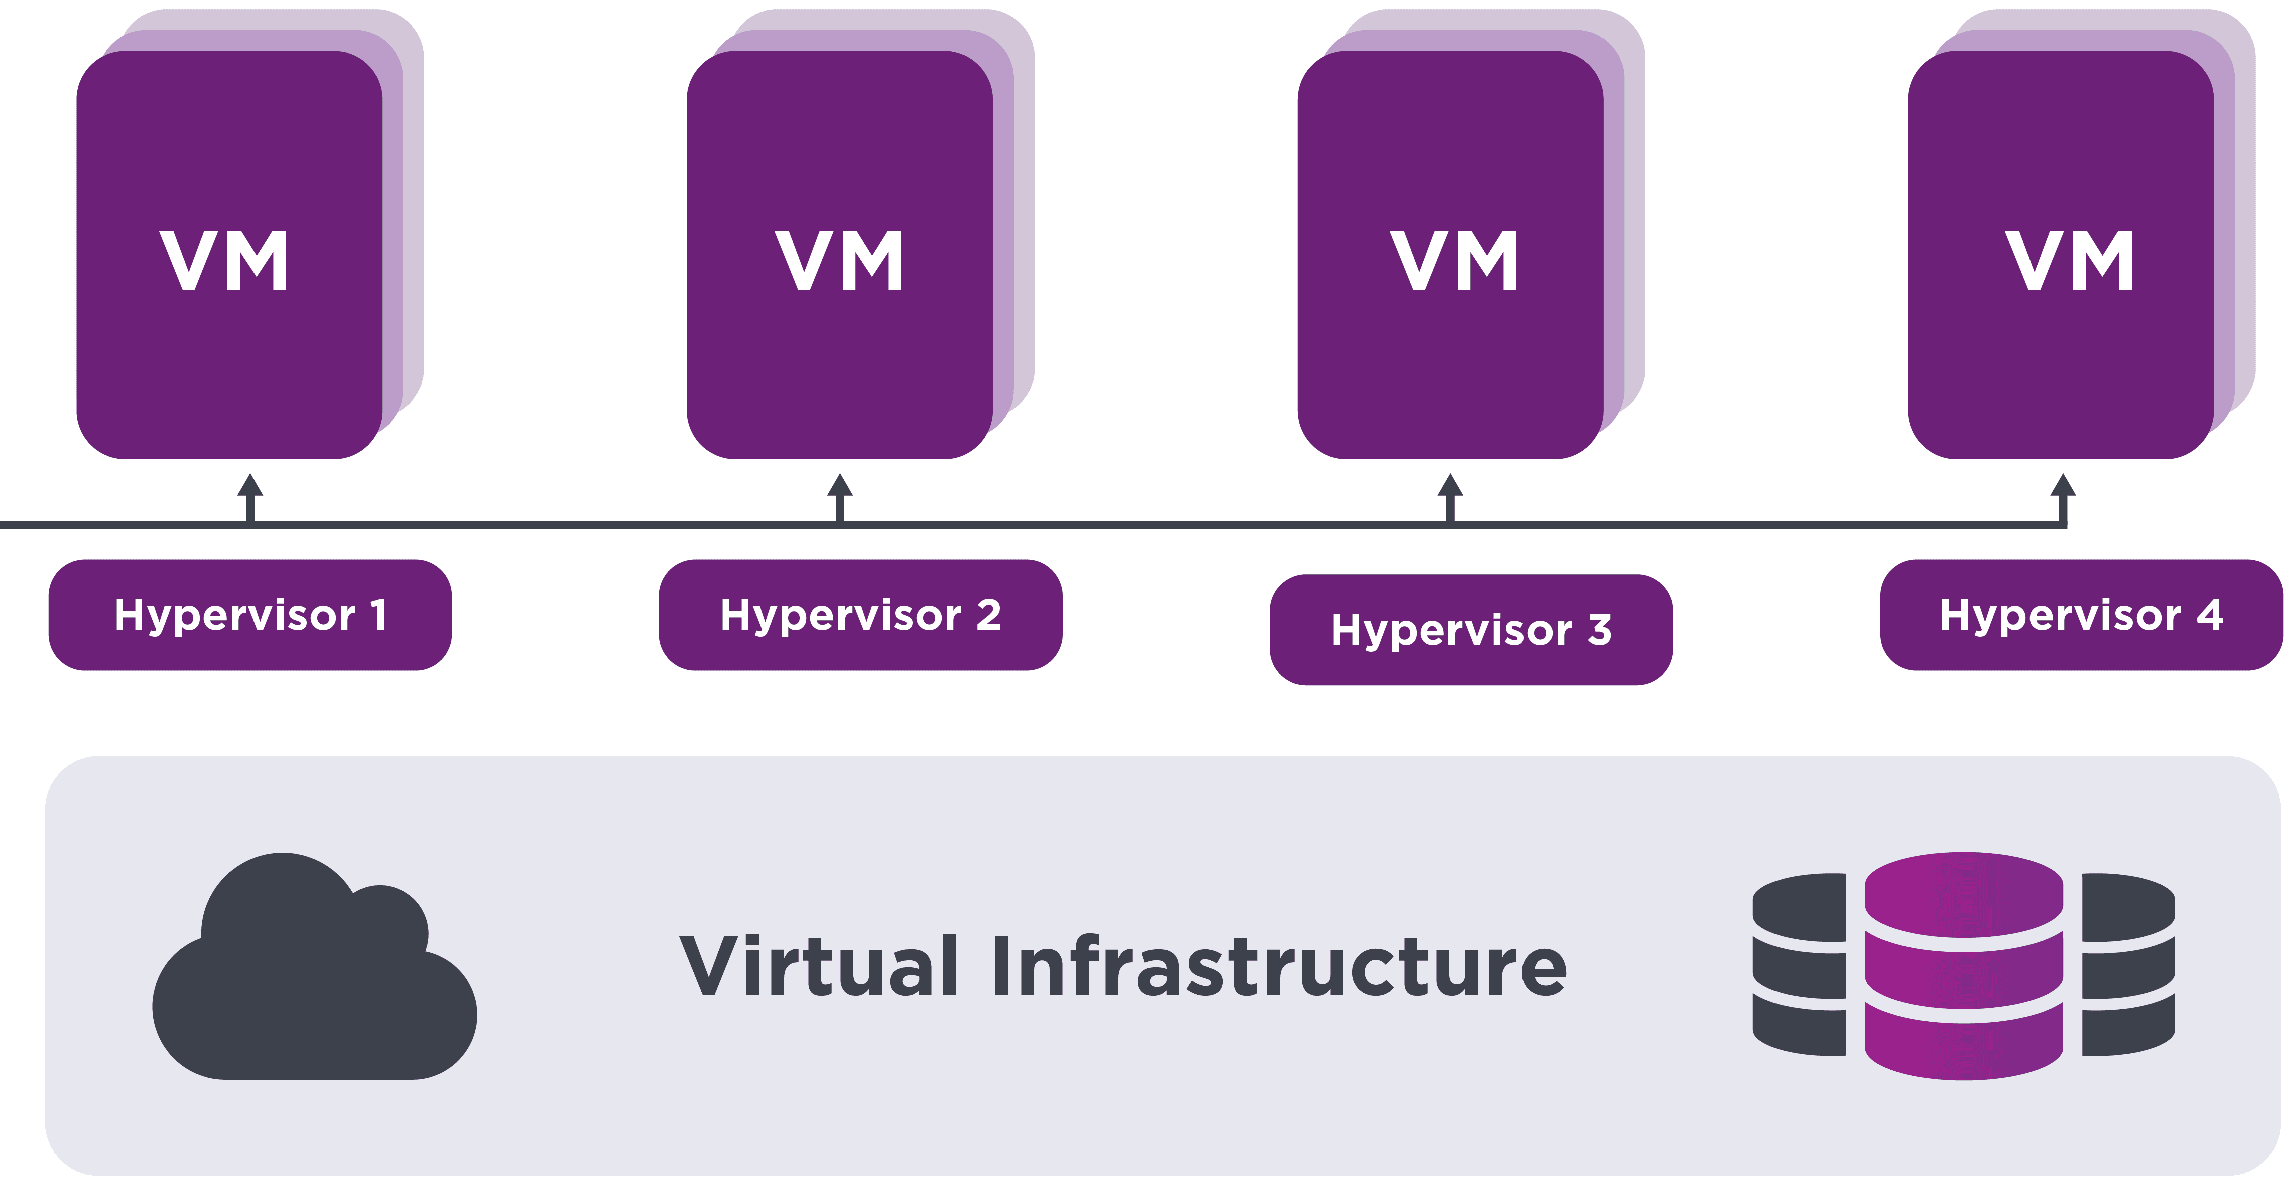
How to Minimize the Risk in Virtualized Environment?
No VM Sprawl: Many VMs created but not managed properly.
Manage Snapshots: Inappropriate VM Snapshot retention period, may cause Storage overload.
Regular Update of Hypervisor/VMs: To minimize the risk of Security Threats.
Network Segmentation: Isolating critical workload and data from major threats.
Audit trails and logging: getting a record of specific activities and data within systems.
VM Encryption: Protecting sensitive data in case of unauthorized access to VMDK files.
https://www.freecodecamp.org/news/vm-data-protection-best-practices/

Slide 21
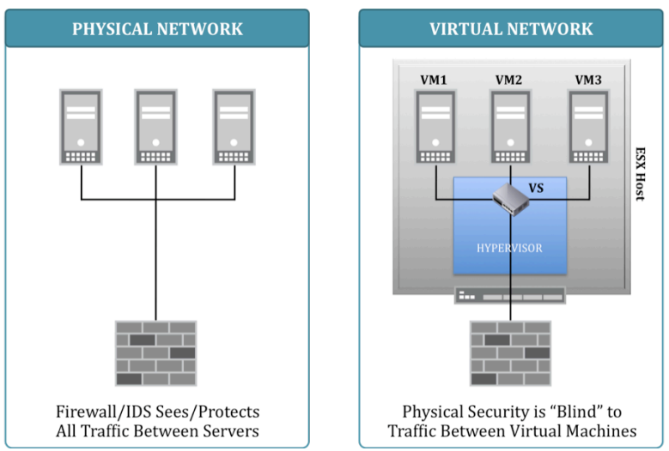
VM Security

Slide 22
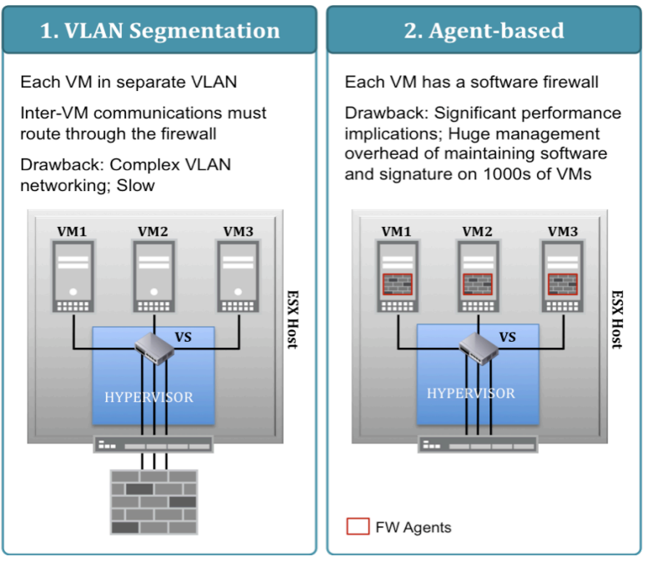
VM Security
http://viewer.media.bitpipe.com/1215444125_915/1265208156_314/5-Best-Practices-To-Protect-Virtual-Environments.pdf

Slide 23
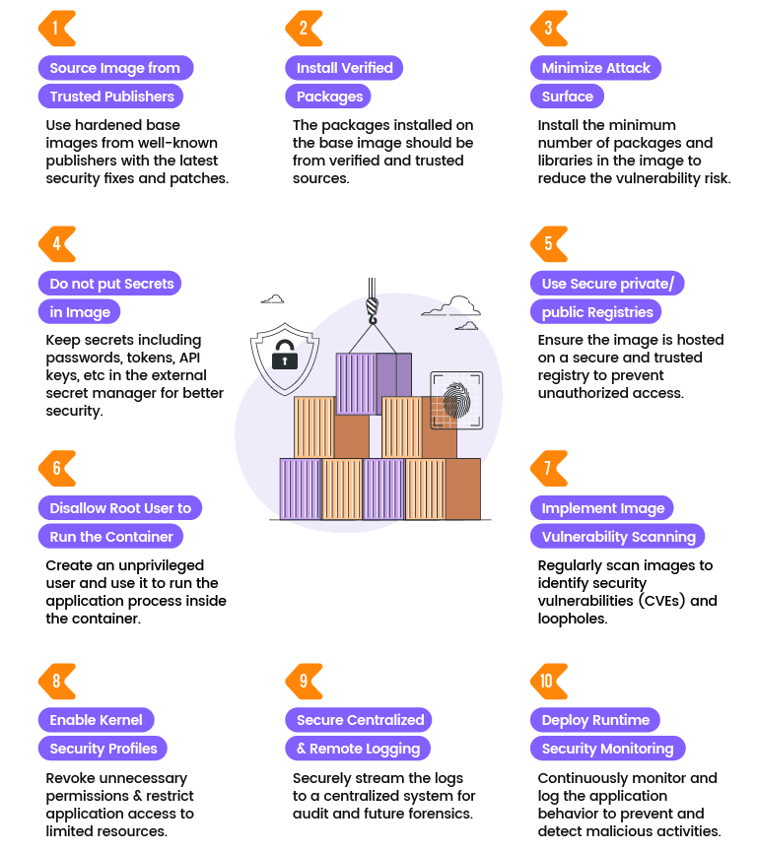
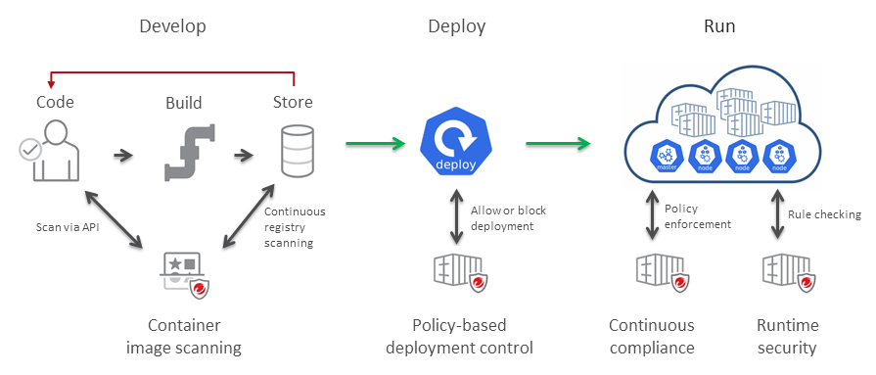
Container Security
Source base image from trusted repositories
Install verified packages
Minimize attack surface in the image
Do not put secrets in the image
Use of secure private or public registries
Do not use privileged user to run the app in a container
Implement image vulnerability scanning in CI/CD
Enable kernel security profiles like AppArmor
Secure centralized and remote logging
Deploy runtime security monitoring
https://www.infracloud.io/blogs/top-10-things-for-container-security/

Slide 24
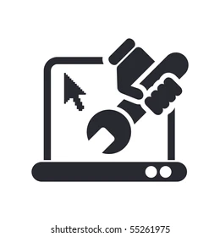
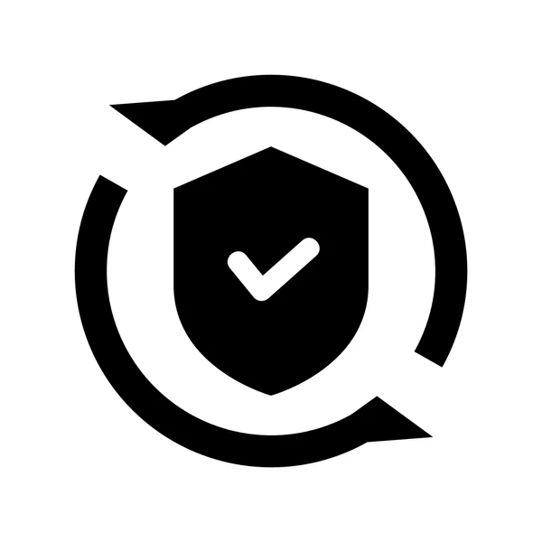
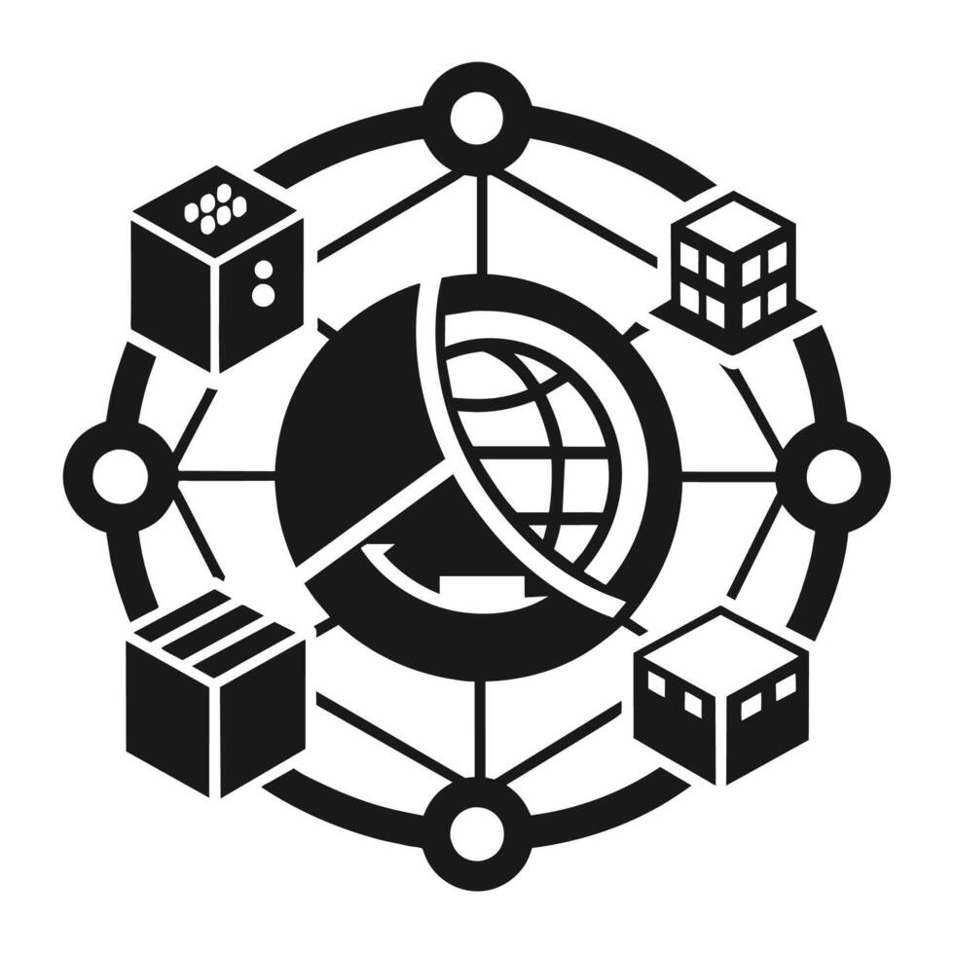

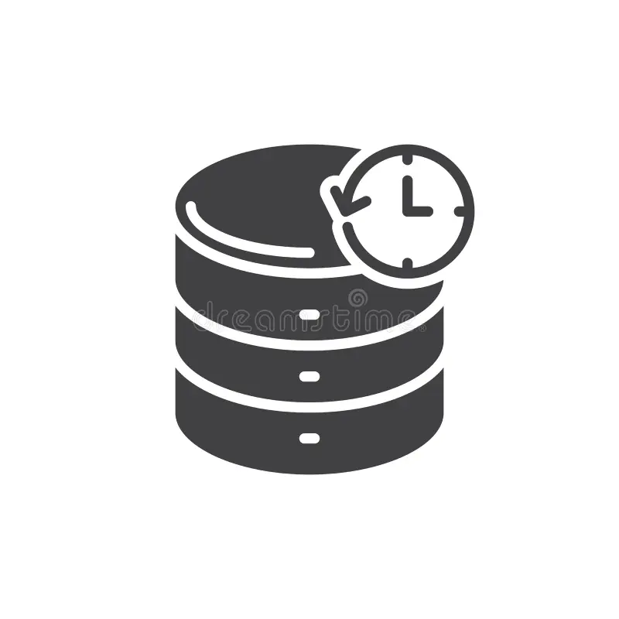

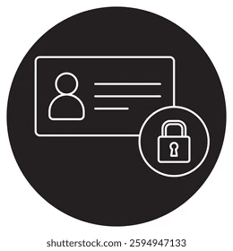
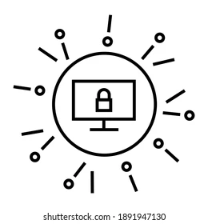

How to Secure a Server?
Download the Latest Operating System (OS)
Pick your OS/Virtualization Framework, wisely (if not using Bare-metal)
Harden your Operating System and Applications (via CIS Controls)
Apply IAM/RBAC to Access Server
Enable MFA to Access your Server/Service
Enable Logging/Auditing (via PAM/Syslog)
Setup Network Segmentation and Limit inbound/outbound Traffic via Firewall Policies
Implement IDPS and SIEM Solutions in your Network
Install EDR/rsyslog/SNMPv3 agent on the Server (for monitoring)
Patch your Operating System and Applications on Monthly basis (Patch Tuesday)
Regular Security Scanning to find Missed Vulnerabilities and Fix them
Schedule regular Backup from your Data on the Server
Monitor Server Functionality/Performance/Security
Define and Implement Clear Change Control process
Encrypt your Data (at-rest/in-transit)
Develop a Comprehensive Incident Response Plan for your Server
Develop a Comprehensive Disaster Recovery Plan for your Server
Use Secure IaC and Version Control to maintain your Server Configuration (GitLab/Jenkins)
Avoid Installing Unknown Packages/Libraries on your Server (Supply Chain Controls)
Provide a Secure Remote Access Mechanism (VPN/MFA)
Deploy Data Loss Prevention (DLP) Solutions to Protect your Data
Apply the Best Security Practices/Standards to your environment (ISO27K/SOC2/GDPR)

Slide 25
Enforcing Security Policies
Company Policies
Prepared/Approved by C-level managers
Security Standards
CIS, PCI DSS, HIPAA, GDPR
Procedures
Tools, Controls, Guidelines
Detection and Mitigation of Security
Risks, Threats and Vulnerabilities

Slide 26
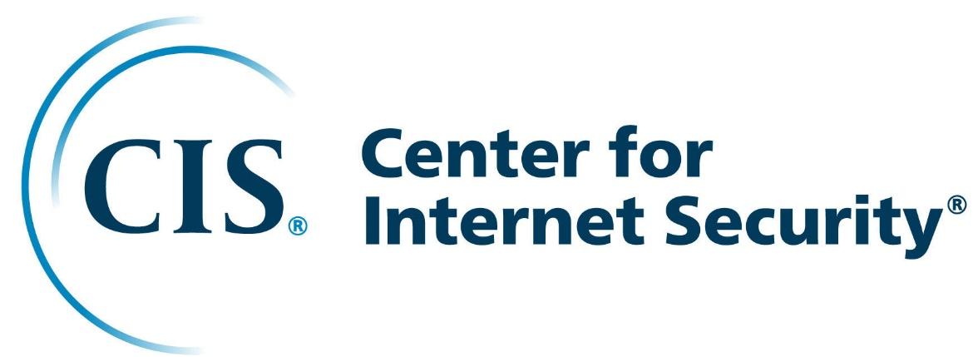


Enforcing Security Policies
Developing the best practice solutions and global security standards as
Security Controls and Benchmarks
www.cisecurity.org
Security Standards
CIS, PCI DSS, HIPAA, GDPR
General Data Protection Regulation
www.gdpr.eu
www.pcisecuritystandards.org
Notes:
PCI-DSS: Payment Card Industry Data Security Standards are designed to guarantee a secure environment to process, store and transmit credit card information.
GDPR: General Data Protection Regulation is a regulation EU law on data protection and privacy of all citizens of EU.

Slide 27
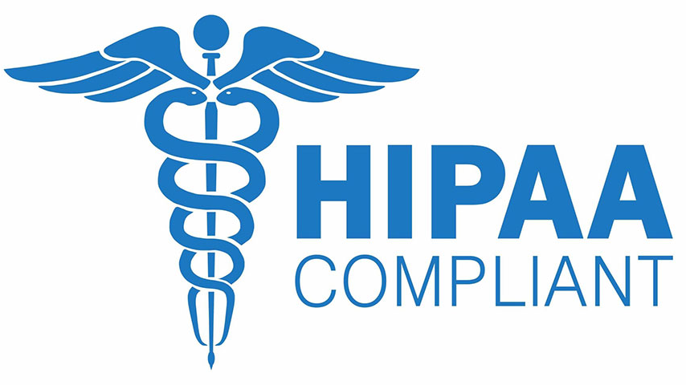
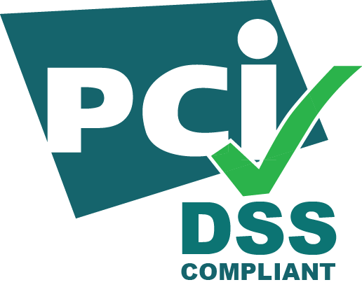
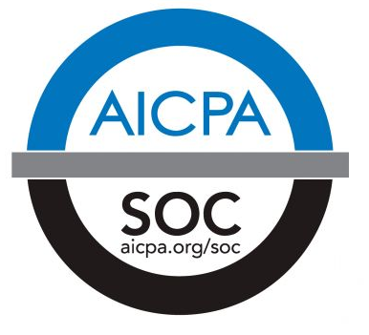

Regulatory Requirements
1. HIPAA (Health Insurance Portability and Accountability Act)
Ensures the protection of sensitive health information by regulating privacy, security, and data breach notifications. It applies to healthcare providers, insurers, and their business associates.
2. PCI-DSS (Payment Card Industry Data Security Standard)
A security standard designed to protect credit card transactions and prevent fraud. It mandates secure handling, storage, and transmission of cardholder data for businesses that process payments.
3. SOC2 (System and Organization Controls)
A framework for assessing an organization's controls around security, availability, processing integrity, confidentiality, and privacy. It is commonly used for SaaS and cloud service providers.
4. FedRAMP (Federal Risk and Authorization Management Program)
A U.S. government program that standardizes security assessments for cloud service providers. It ensures federal agencies use secure and compliant cloud solutions
5. GDPR (General Data Protection Regulation):
It is a comprehensive data protection law that establishes strict rules for the processing, storage, and transfer of personal data of individuals within the European Union. It mandates that organizations obtain explicit consent for data processing, implement strong data protection measures, and provide individuals with clear rights over their personal information.
6. ISO27000K:
It refers to a family of international standards, including ISO/IEC 27001, that guide organizations in establishing and maintaining robust information security management systems (ISMS). These standards emphasize the importance of risk assessment, continuous improvement, and comprehensive security controls to protect critical information assets.
Notes:
To meet these regulatory requirements, businesses must implement comprehensive cloud security measures. This includes:
Using encryption to protect data in transit and at rest
Establishing access control systems to ensure that only authorized personnel can view, OR
Modify sensitive information, and conduct regular security audits

Slide 28
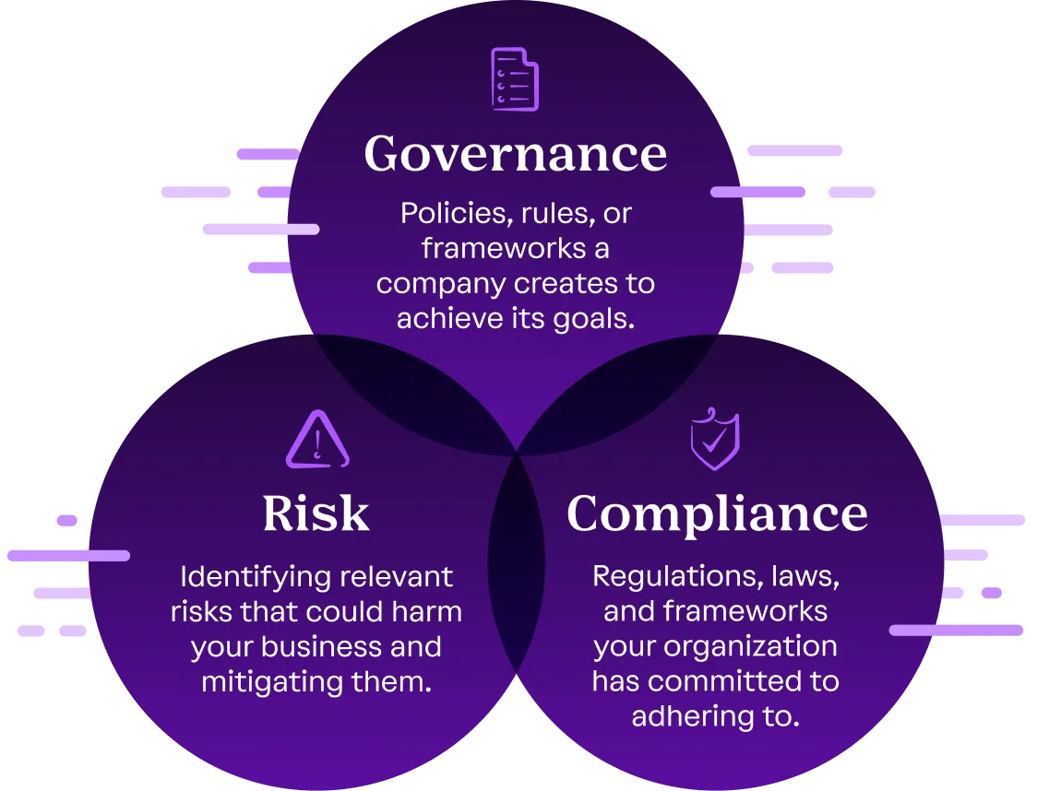
GRC (Governance, Risk, Compliance)
What is GRC (Governance, Risk, and Compliance)?
GRC (Governance, Risk, and Compliance) is a structured approach that organizations use to align their IT and business strategies with regulatory requirements while effectively managing risks. It consists of three key components, which are as follows:
Governance (G) – Ensures that the organization's operations align with business objectives, ethical standards, and stakeholder expectations.
Risk Management (R) – Identifies, assesses, and mitigates risks that could impact the organization's security, financial health, and reputation.
Compliance (C) – Ensures the organization follows relevant laws, regulations, and industry standards, such as GDPR, ISO-27001, or SOC2.
Notes:
What is GRC (Governance, Risk, and Compliance)?
GRC (Governance, Risk, and Compliance) is a structured approach that organizations use to align their IT and business strategies with regulatory requirements while effectively managing risks. It consists of three key components:
Governance (G) – Ensures that the organization's operations align with business objectives, ethical standards, and stakeholder expectations.
Risk Management (R) – Identifies, assesses, and mitigates risks that could impact the organization's security, financial health, and reputation.
Compliance (C) – Ensures the organization follows relevant laws, regulations, and industry standards, such as GDPR, ISO 27001, or SOC 2.
Why Do Organizations Need GRC?
Regulatory Compliance – Avoids legal penalties and ensures adherence to industry regulations.
Risk Mitigation – Protects against cybersecurity threats, financial losses, and operational risks.
Operational Efficiency – Streamlines internal processes, reducing redundancies and inefficiencies.
Reputation Management – Prevents reputational damage by ensuring ethical and legal business conduct.
Strategic Decision-Making – Provides data-driven insights to align business goals with risk tolerance.
A well-implemented GRC framework helps organizations maintain resilience, security, and trust with stakeholders.

Slide 29
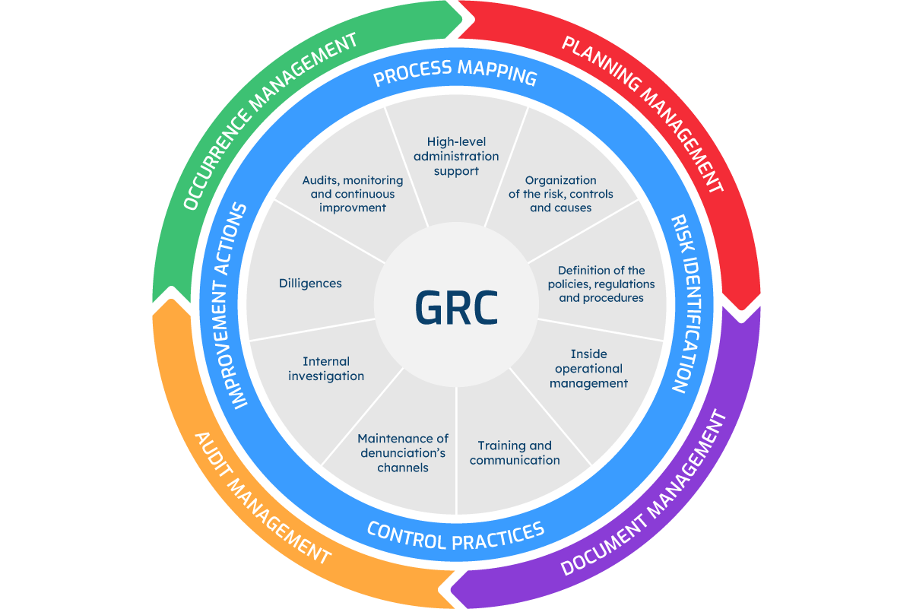
GRC (Governance, Risk, Compliance)
Why Do Organizations Need GRC?
Regulatory Compliance – Avoids legal penalties and ensures adherence to industry regulations.
Risk Mitigation – Protects against cybersecurity threats, financial losses, and operational risks.
Operational Efficiency – Streamlines internal processes, reducing redundancies and inefficiencies.
Reputation Management – Prevents reputational damage by ensuring ethical and legal business conduct.
Strategic Decision-Making – Provides data-driven insights to align business goals with risk tolerance.
Notes:
What is GRC (Governance, Risk, and Compliance)?
GRC (Governance, Risk, and Compliance) is a structured approach that organizations use to align their IT and business strategies with regulatory requirements while effectively managing risks. It consists of three key components:
Governance (G) – Ensures that the organization's operations align with business objectives, ethical standards, and stakeholder expectations.
Risk Management (R) – Identifies, assesses, and mitigates risks that could impact the organization's security, financial health, and reputation.
Compliance (C) – Ensures the organization follows relevant laws, regulations, and industry standards, such as GDPR, ISO 27001, or SOC 2.
Why Do Organizations Need GRC?
Regulatory Compliance – Avoids legal penalties and ensures adherence to industry regulations.
Risk Mitigation – Protects against cybersecurity threats, financial losses, and operational risks.
Operational Efficiency – Streamlines internal processes, reducing redundancies and inefficiencies.
Reputation Management – Prevents reputational damage by ensuring ethical and legal business conduct.
Strategic Decision-Making – Provides data-driven insights to align business goals with risk tolerance.
A well-implemented GRC framework helps organizations maintain resilience, security, and trust with stakeholders.

Slide 30
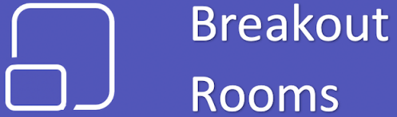
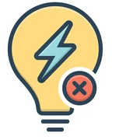
Real World Examples
1
Search for a company or organization that has publicly shared information about a compliance.
SOC2: A cloud service provider might have a dedicated webpage for its SOC2 Type II report, detailing security controls and audit results.
PCI-DSS: A retail company may share how it secures payment transactions and complies with PCI standards to build customer trust.
GDPR: A multinational tech company might describe its data handling policies and user consent processes as part of GDPR compliance.
ISO27K: A financial institution might explain its implementation of an Information Security Management System (ISMS) and its certification journey.
Each student will search for these four points and then they comment on similarities or differences among the standards and how each example underscores the importance of GRC in the modern business environment.

Slide 31
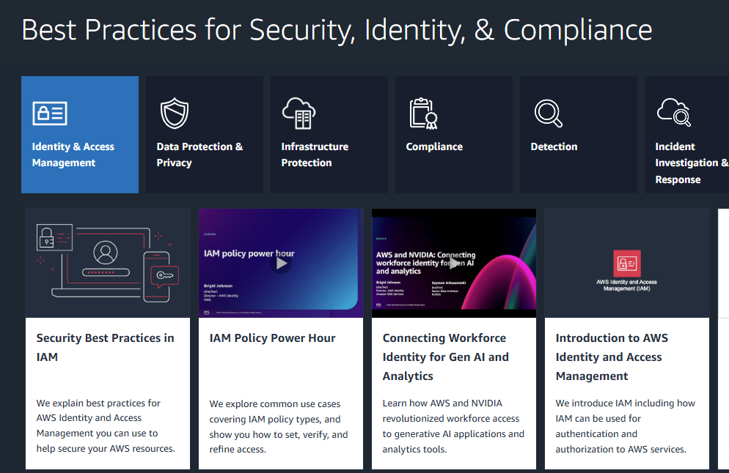
Best Cloud Security Practices
Check
https://aws.amazon.com/architecture/security-identity-compliance/

Slide 32

Best Cloud Security Practices
Check
https://cloud.google.com/security/best-practices

Slide 33


Popular Courses on Cloud/Cyber Security
https://www.cyber.gc.ca/en/guidance/certifications-field-cyber-security

Slide 34
Real World Examples
2
Individually search for two cyberattack incidents that occurred as a result of not following best security practices in cloud environments.
Identify key details for each incident, including the type of cloud service involved, the nature of the security lapse (e.g., misconfigured storage, insufficient access controls), and the impact of the attack.
For each incident, write a short analysis (3–4 sentences) that covers:
What went wrong: Describe the specific security best practices that were neglected.
Impact: Outline the consequences of the cyberattack on the affected organization.
Lessons Learned: Explain what could have been done to prevent the incident.

Slide 35


End of Lecture #10
Next Week, Project Presentation
15-20 min Presentation
5-10 min Q&A
THANK Y☺U
- Dawood Sajjadi

